Slide 1
Technology for Producing High Quality Tactile Graphics Lucia Hasty, MA, CTVI Rocky Mountain Braille Associates

Slide 2
Virginia AER 2013

Slide 4
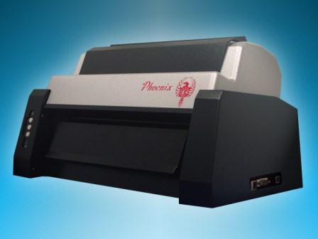
PHOENIX Braille and tactile graphics embosser Enabling Technologies

Slide 5
Good things to know about the Firebird software
Easy to learn
Continually updated with new features to improve
graphics production
Updates free, downloadable from Enabling website
Copy and paste braille from your translation program
into an image in Firebird.
Compliant with the BANA Guidelines and Standards for Tactile Graphics

Slide 7
www.brailleauthority.org/tg
Html version for download
Searchable
Printable .pdf version
Print and braille versions for purchase- APH
Supplement with examples of TGs- APH

Slide 8
Good things to know about the Phoenix embosser, continued
Have produced over 1500 tactile graphics with my Phoenix
Has produced steadily with no maintenance problems
Option to emboss on wide or narrow paper
Two embossing heads- one for text and one for high resolution graphics
Standard Library of Congress braille for text

Slide 9
More good things to know about the Phoenix embosser
Price is reasonable for a dual purpose embosser.
Enabling’s Tech Support is superb.

Slide 10
FEATURES
Dual embossing heads-
one for standard braille (text)
one for high resolution graphics
Single-sided embossing
8.5” or 11.5” wide tractor-feed paper

Slide 11
Software: FIREBIRD GRAPHICS
Create graphic from a scanned image to which various filters are applied
Will open gif, tiff, jpg, png, bmp files
Will not open pdf, prn, brg files
Simplified drawing program included

Slide 12
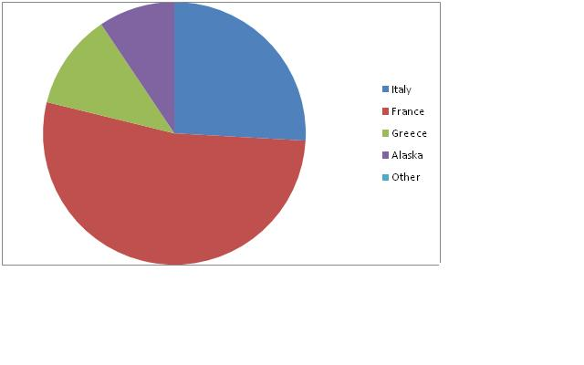

Slide 13
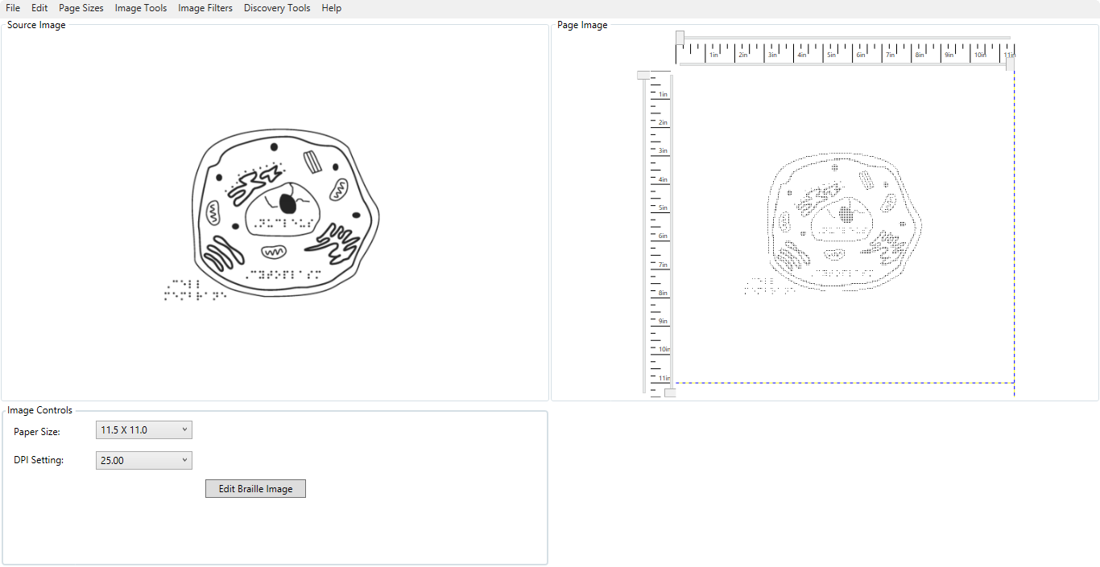
Animal Cell- APH Tactile Graphic Image Library

Slide 14
Free software for images
Paint.net
http://www.cnet.com/1770-5_1-0.html?query=paint.net&tag=srch
Inkscape
http://inkscape.downloadasaurus.com/

Slide 15
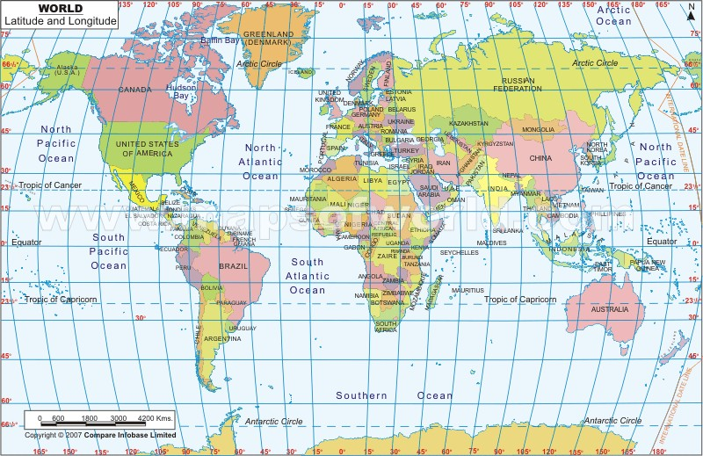

Slide 16
Thank you for coming today.
Contact me if you have more questions.
Lucia@tactilegraphics.org

